Slide 1
What Do Compilers Do (1)
A compiler acts as a translator,
transforming human-oriented programming languages
into computer-oriented machine languages.
  Ignore machine-dependent details for programmer
Programming
Language
(Source)
Machine
Language
(Target)
Compiler

Slide 2
The Structure of a Compiler (1)
Any compiler must perform two major tasks
  Analysis of the source program
  Synthesis of a machine-language program
Compiler
Analysis
Synthesis

Slide 3





The Structure of a Compiler (2)
Source
Program
Scanner
Tokens
Parser
Syntactic
Semantic
Routines
(Character Stream)
Structure
Intermediate
Representation
Symbol and
Attribute
Tables
Optimizer
(Used by all Phases of The Compiler)
Code
Generator
Target machine code

Slide 4


The Structure of a Compiler (3)
Source
Program
Scanner
Tokens
Parser
Syntactic
Semantic
Routines
(Character Stream)
Structure
Intermediate
Representation
Scanner
  The scanner begins the analysis of the source program by reading the input, character by character, and grouping characters into individual words and symbols (tokens)
RE ( Regular expression )
NFA ( Non-deterministic Finite Automata )
DFA ( Deterministic Finite Automata )
LEX
Symbol and
Attribute
Tables
Optimizer
(Used by all
Phases of
The Compiler)
Code
Generator
Target machine code

Slide 5

The Structure of a Compiler (4)
Source
Program
Scanner
Tokens
Parser
Syntactic
Semantic
Routines
(Character Stream)
Structure
Intermediate
Representation
Parser
Given a formal syntax specification (typically as a context-free grammar [CFG] ), the parse reads tokens and groups them into units as specified by the productions of the CFG being used.
As syntactic structure is recognized, the parser either calls corresponding semantic routines directly or builds a syntax tree.
CFG ( Context-Free Grammar )
BNF ( Backus-Naur Form )
GAA ( Grammar Analysis Algorithms )
LL, LR, SLR, LALR Parsers
YACC
Symbol and
Attribute
Tables
Optimizer
(Used by all
Phases of
The Compiler)
Code
Generator
Target machine code

Slide 6


The Structure of a Compiler (5)
Source
Program
Scanner
Tokens
Parser
Syntactic
Semantic
Routines
(Character Stream)
Structure
Intermediate
Representation
Semantic Routines
Perform two functions
  Check the static semantics of each construct
  Do the actual translation
The heart of a compiler
Syntax Directed Translation
Semantic Processing Techniques
IR (Intermediate Representation)
Symbol and
Attribute
Tables
Optimizer
(Used by all
Phases of
The Compiler)
Code
Generator
Target machine code

Slide 7


The Structure of a Compiler (6)
Source
Program
Scanner
Tokens
Parser
Syntactic
Semantic
Routines
(Character Stream)
Structure
Intermediate
Representation
Optimizer
The IR code generated by the semantic routines is analyzed and transformed into functionally equivalent but improved IR code
This phase can be very complex and slow
Peephole optimization
loop optimization, register allocation, code scheduling
Register and Temporary Management
Peephole Optimization
Symbol and
Attribute
Tables
Optimizer
(Used by all
Phases of
The Compiler)
Code
Generator
Target machine code

Slide 8

The Structure of a Compiler (7)
Source
Program
Scanner
Tokens
Parser
Syntactic
Semantic
Routines
(Character Stream)
Structure
Intermediate
Representation
Code Generator
Interpretive Code Generation
Generating Code from Tree/Dag
Grammar-Based Code Generator
Optimizer
Code
Generator
Target machine code

Slide 9
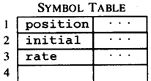


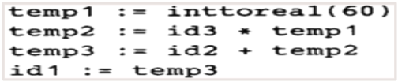



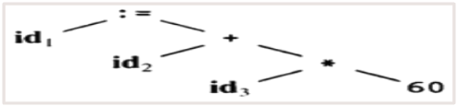



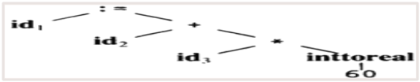
The Structure of a Compiler (8)
Code Generator
[Intermediate Code Generator]
Non-optimized Intermediate Code
Scanner
[Lexical Analyzer]
Tokens
Code Optimizer
Parser
[Syntax Analyzer]
Optimized Intermediate Code
Parse tree
Code Optimizer
Semantic Process
[Semantic analyzer]
Target machine code
Abstract Syntax Tree w/ Attributes

Slide 10
The Structure of a Compiler (9)
  Compiler writing tools
    Compiler generators or compiler-compilers
      E.g. scanner and parser generators
      Examples : Yacc, Lex

Slide 11
The Syntax and Semantics of Programming Language (1)
A programming language must include the specification of syntax (structure) and semantics (meaning).
Syntax typically means the context-free syntax because of the almost universal use of context-free-grammar (CFGs)
Ex.
  a = b + c is syntactically legal
  b + c = a is illegal

Slide 12
The Syntax and Semantics of Programming Language (2)
The semantics of a programming language are commonly divided into two classes:
  Static semantics
    Semantics rules that can be checked at compiled time.
    Ex. The type and number of a function’s arguments
  Runtime semantics
    Semantics rules that can be checked only at run time

Slide 13
Compiler Design and Programming Language Design (1)
An interesting aspect is how programming language design and compiler design influence one another.
Programming languages that are easy to compile have many advantages

Slide 14
Compiler Design and Programming Language Design(2)
Languages such as Snobol and APL are usually considered noncompilable
What attributes must be found in a programming language to allow compilation?
  Can the scope and binding of each identifier reference be determined before execution begins?
  Can the type of object be determined before execution begins?
  Can existing program text be changed or added to during execution?

Slide 15
Computer Architecture and Compiler Design
Compilers should exploit the hardware-specific feature and computing capability to optimize code.
The problems encountered in modern computing platforms:
  Instruction sets for some popular architectures are highly nonuniform.
  High-level programming language operations are not always easy to support.
    Ex. exceptions, threads, dynamic heap access …
  Exploiting architectural features such as cache, distributed processors and memory
  Effective use of a large number of processors

Slide 16
Compiler Design Considerations
Debugging Compilers
  Designed to aid in the development and debugging of programs.
Optimizing Compilers
  Designed to produce efficient target code
Retargetable Compilers
  A compiler whose target architecture can be changed without its machine-independent components having to be rewritten.

Slide 17
Interpreters (1)
Machine-independent
Significant overhead
Interpreter
Output
Source Program Encoding
Input Data

